Slide 1
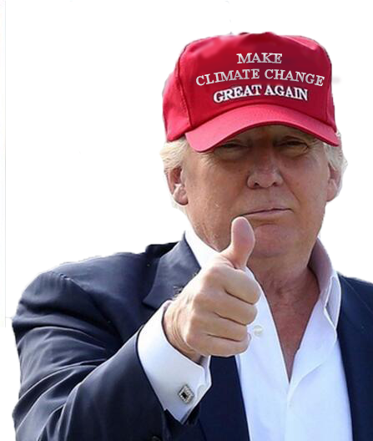
Making Climate Change Great Again
Jessica T. , Laura H.
Nam L. , Bryan K.

Slide 2
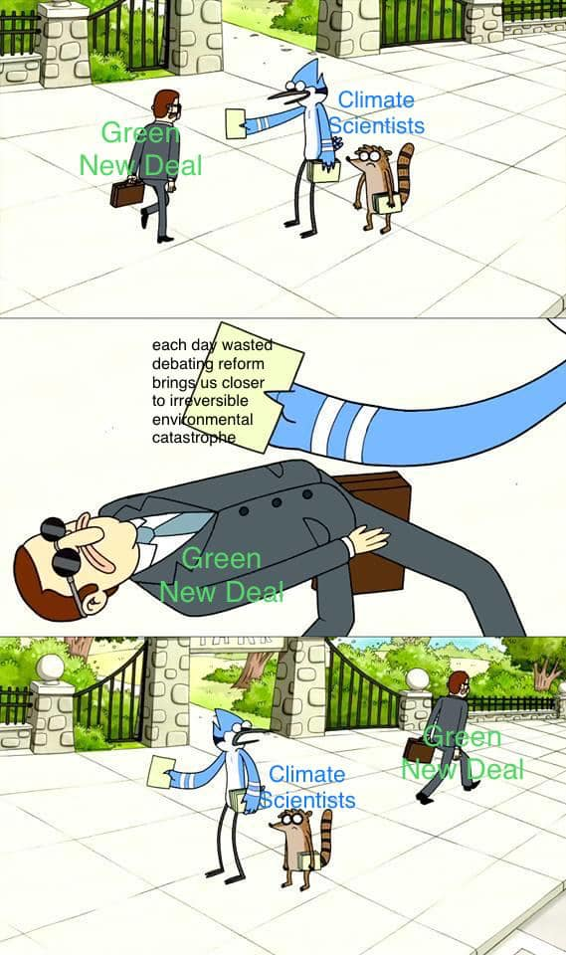
What is the Goal?
Looking at climate data to find any anomalies that would have been influenced by the 2016 elections or other geo-political factors

Slide 3
Questions the Team will Tackle
Have any of Trump’s policies influenced the climate data sets?
Have other major countries met their emissions goals?
How long would it take for specific countries to meet their emissions or climate goals?

Slide 4
Have other major countries met their emissions goals?
PARIS AGREEMENT
Since the Paris Agreement of 2015, 196 countries have committed to the agreement in efforts to deal with greenhouse-gas-emissions mitigation, adaption, and finance in order to combatant climate change.
DESPITE AGREEMENT
Global carbon emissions continue to increase despite the agreement and makes the recent years to be the hottest on record. Using data from Climate Action Tracker we can find which countries are making the best efforts and which countries are failing to meet their goals.

Slide 5
The good, the bad,
TOP OF THE CLASS
Between the 6 major countries we decided to analyze, India comes out at the top of the class for meeting its emissions goals. India has emerged as a global leader in renewable energy and continues to invest more in them than fossil fuels which greatly increases India’s plan to generate 40 percent of its power through renewables by 2030. Amazing!
SHOWS SIGNS OF PROMISE
China is somewhat of many irony. China is on course to meet its Paris targets, though it is only for the fact that the targets to meet are highly inadequate, and are not ambitious enough to limit warming to below 2 degrees C, in which the Paris Agreement requires a min of at least limiting warming to 1.5 degrees C. Furthermore, in 2018, Chinese consumers bought more electric vehicles than the rest of the world combined. China is also the largest manufacturer of solar technology in the world, but through all the positive means of these consuming and manufacturing, China is also the largest consumer of coal, and continues to finance the construction of coal fired power stations all over the world.

Slide 6
And the ugly
BARELY TRYING..
Climate Action Tracker ranked United States Paris targets as “critically insufficient.” Trump’s Administration’s ongoing hostility toward climate action and attempts to roll back the Clean Power Plan, the administration furthers to make plans to weaken regulations to limit HFC emissions and regulations of methane leaks from gas and oil productions. Ultimately the administration has signaled its intent to withdraw form the Paris Agreement in 2020 altogether.

Slide 7
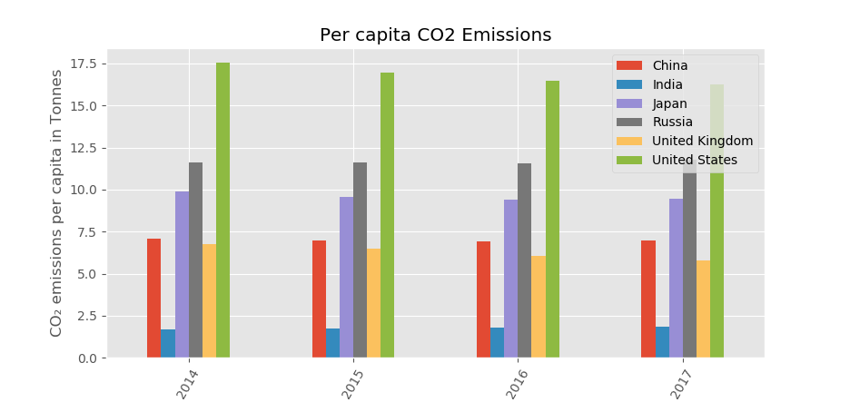
Bar Graph to show Example of Emissions

Slide 8
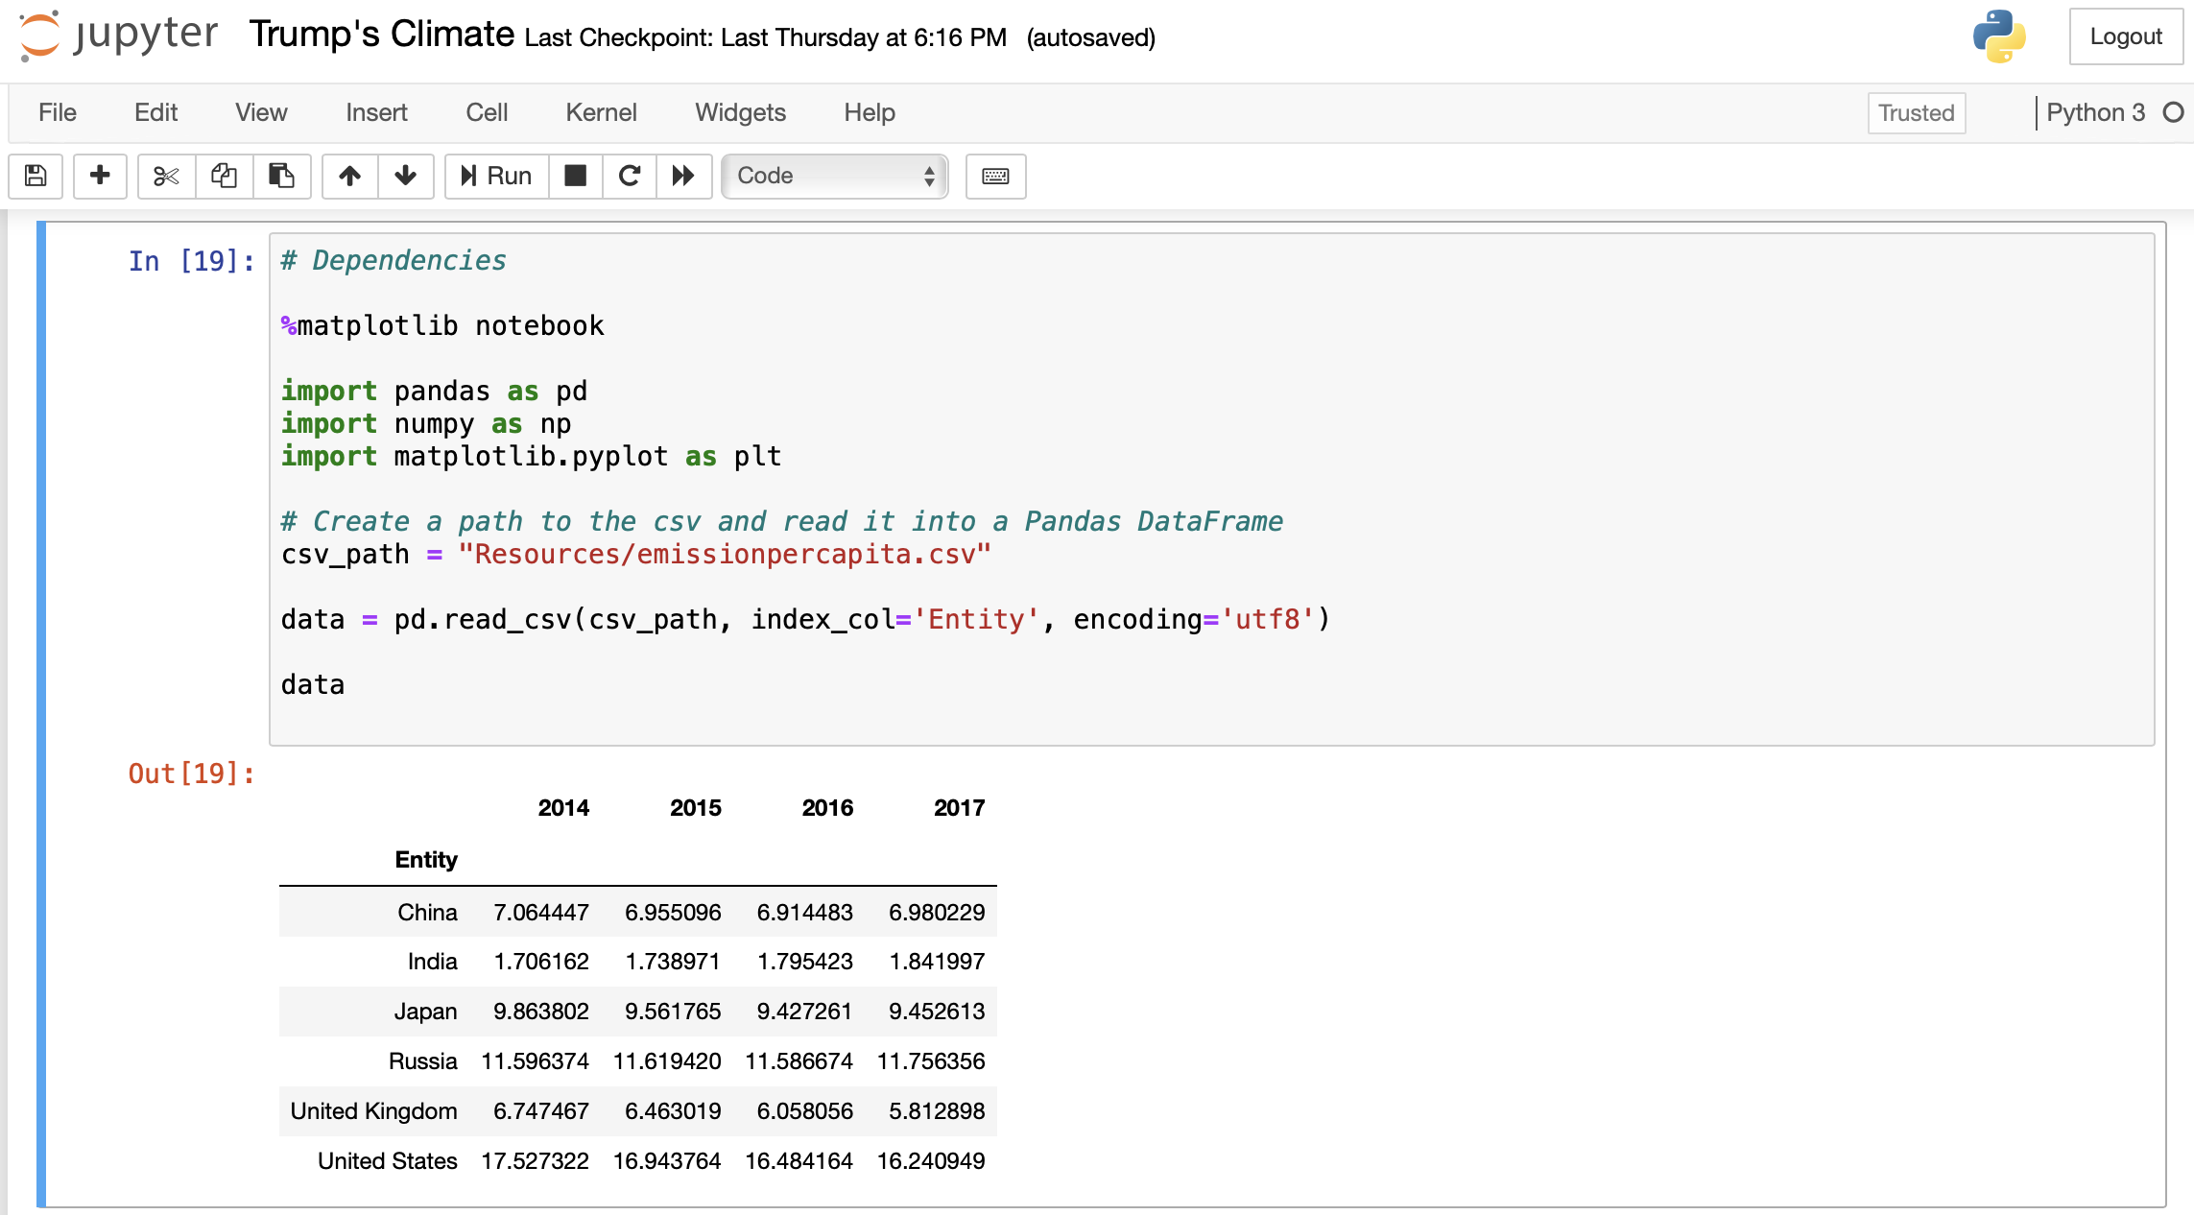

Slide 9
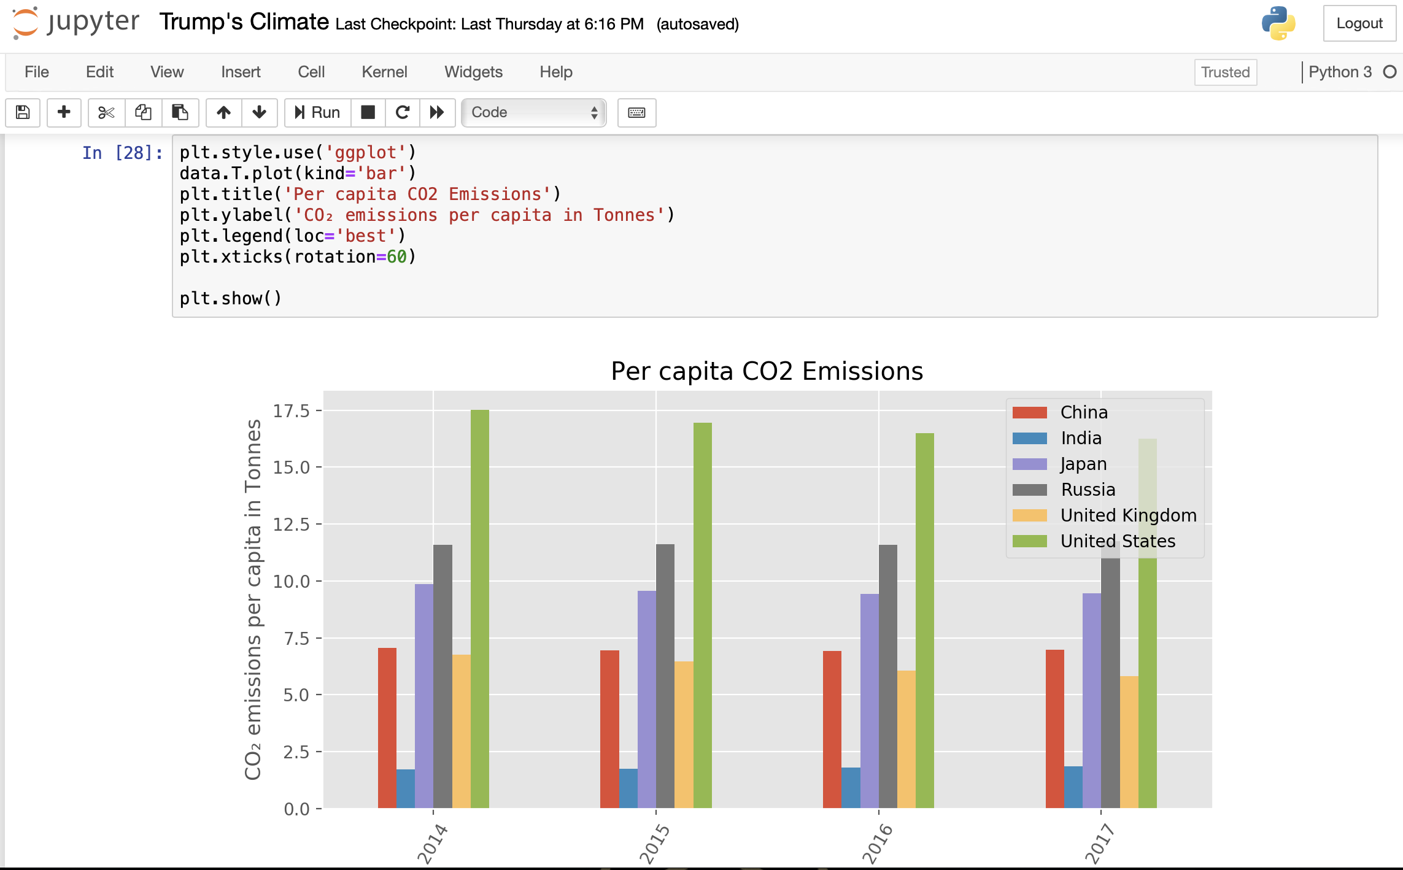

Slide 10
Cumulative Emissions by Top Contributing Nations

Slide 11
Which nation has contributed most to Global Emissions?
KEY POINTS
The United States has emitted more CO2 than any other country to date: at around 400 billion tonnes since 1751 and it is responsible for 25% of historical emissions;
That is twice more than China-the world’s second largest national contributor;
The 28 countries of the European Union (EU-28)-which are grouped together here as they typically negotiate and set targets on a collaborative basis-is also a large historical contributor at 22%;
Many of the Large annual emitters today, such as India and Brazil, are not large contributors in a historical context;
Data was found using ourworldindata.org
The EU, although a top contributor, remained relatively steady during the 2014-2017 time-frame.

Slide 12
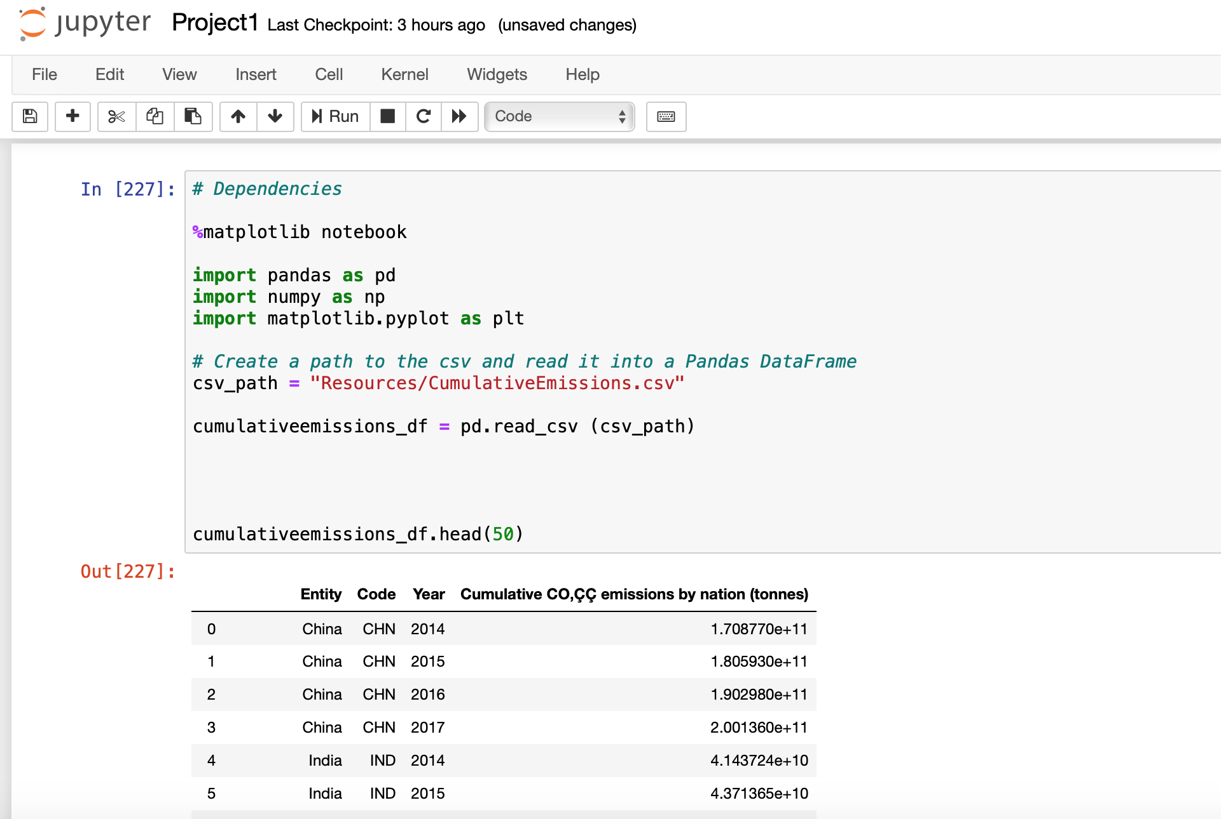

Slide 13
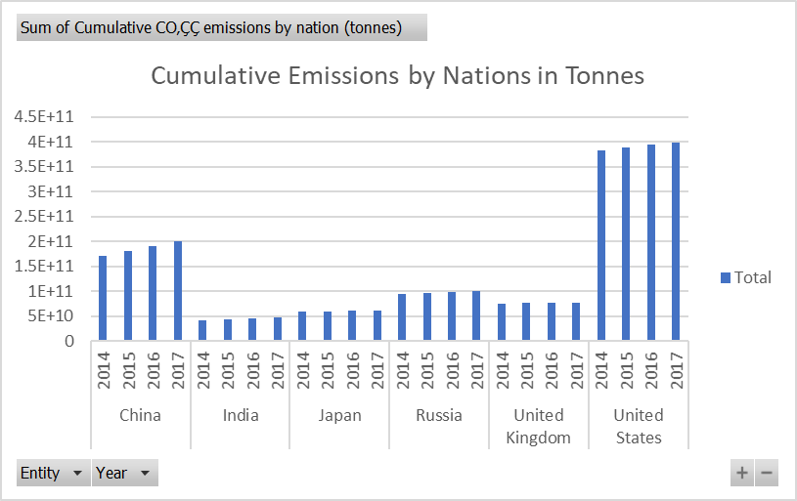

Slide 14
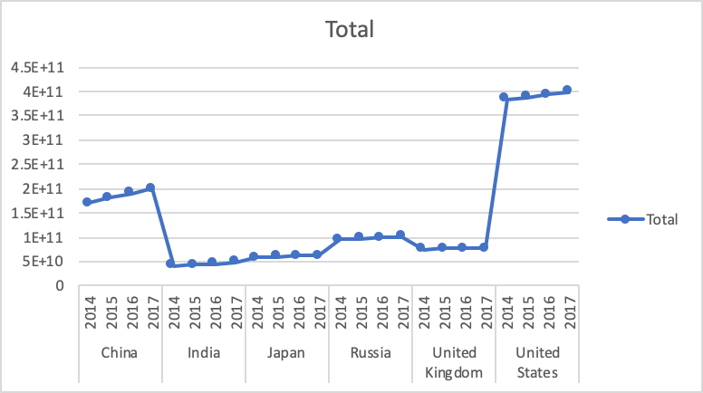

Slide 15
What can we gather from this information?
There has been a steady increase in emission rates in the top emission contributors.
The United States and China have seen the biggest increase in from 2014-2017.
It can be gathered that the United States only contributes a small percentage to the World’s population, but is the largest contributor of CO2 emissions.

Slide 16
Annual Co2 Emissions
How are we doing compared to the rest of the world?

Slide 17
Essential Questions
Impact
Progress by Nation
Implications
Have any of Trump’s policies influenced the climate data sets?
Have other major countries met their emissions goals?
Implications of findings?

Slide 18


The Where, How & What
Data Exploration and Cleanup Process
Hannah Ritchie and Max Roser (2019) - "CO₂ and Greenhouse Gas Emissions". Published online at OurWorldInData.org. Retrieved from: 'https://ourworldindata.org/co2-and-other-greenhouse-gas-emissions' [Online Resource]
Notes:
Authors: Hannah Ritchie and Max Roser
First publication May 2017, last revised in December 2019

Slide 19
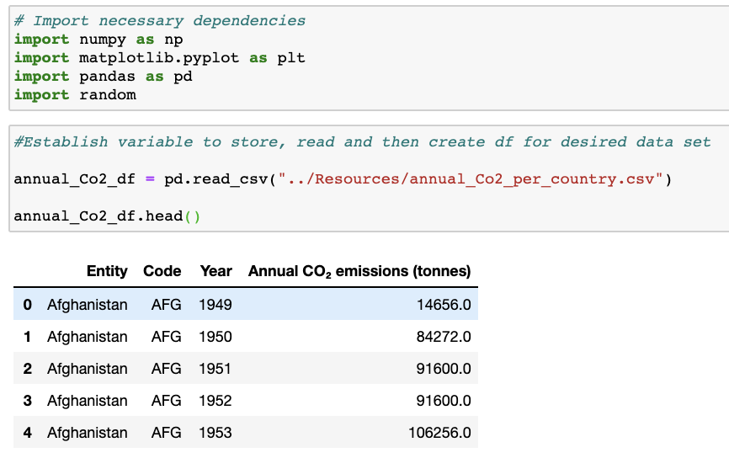
The Where, How & What
Data Exploration and Cleanup Process

Slide 20
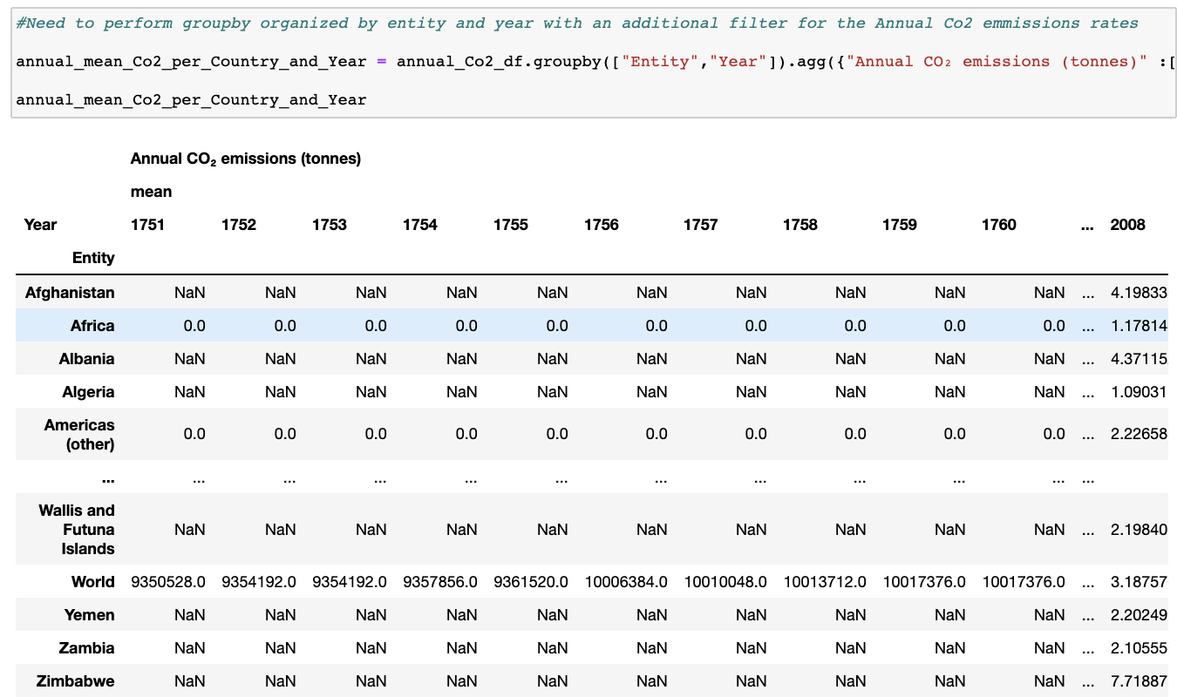
The Where, How & What
Data Exploration and Cleanup Process

Slide 21
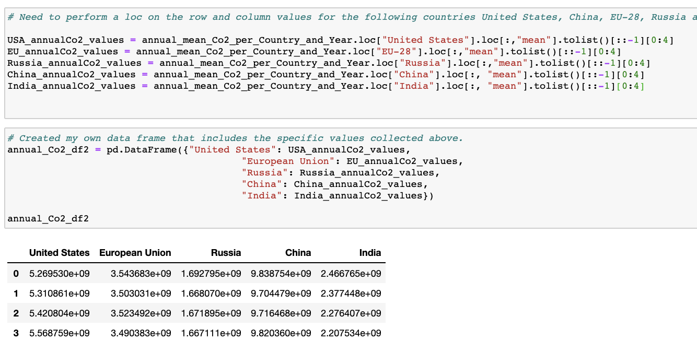
The Where, How & What
Data Exploration and Cleanup Process

Slide 22
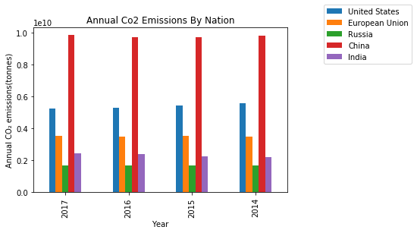
Visualization 1
Annual Co2 Emissions By Nation

Slide 23
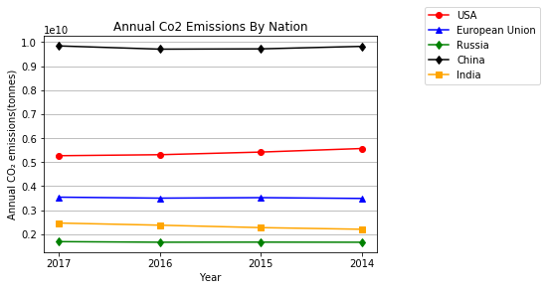
Visualization 2
Annual Co2 Emissions By Nation

Slide 24
Essential Questions- Answered
Impact
Progress by Nation
Implications
Slight Decline
Since 2014, the United States has seen close to 5% decline in annual Co2 emissions.
Improvement is a Must
While the USA has had a decline recently, we are still responsible for 15-18% of the global emissions in the world (2nd largest).
Our Decisions Matter
Annual Co2 emissions rates are resulting in negative environmental consequences that are jeopardizing living conditions for future generations.
Notes:
Section 1: In a moment my project partner Laura will discuss why that information could be misleading.
Section 3: Our withdrawal from the Paris Agreement does not make things any easier.

Slide 25
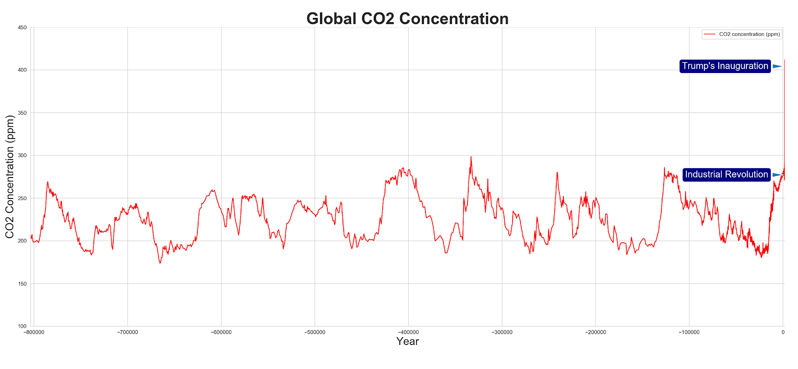
This graph illustrates global atmospheric CO2 concentration in parts per million.
Global annual CO2 concentration has increased 45% since the start of the Industrial Revolution.
This rapid increase is attributed to human activity and the adoption of hydrocarbon fuel sources.

Slide 26
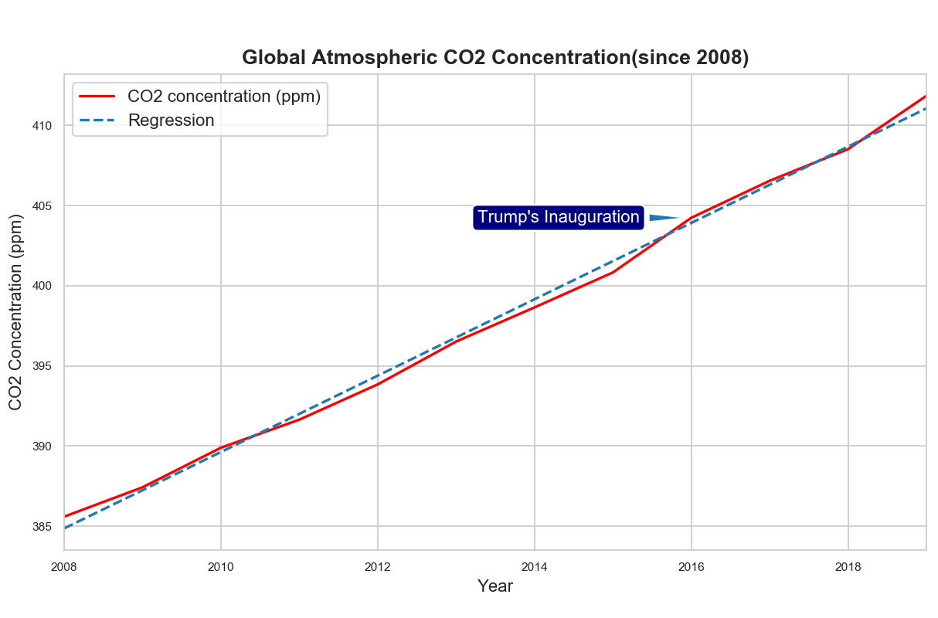
Data filtered to only years since 2008 and fit with a regression line to predict the trend.
For the majority of Trump’s time in office, global CO2 concentration has measured above the trend.

Slide 27
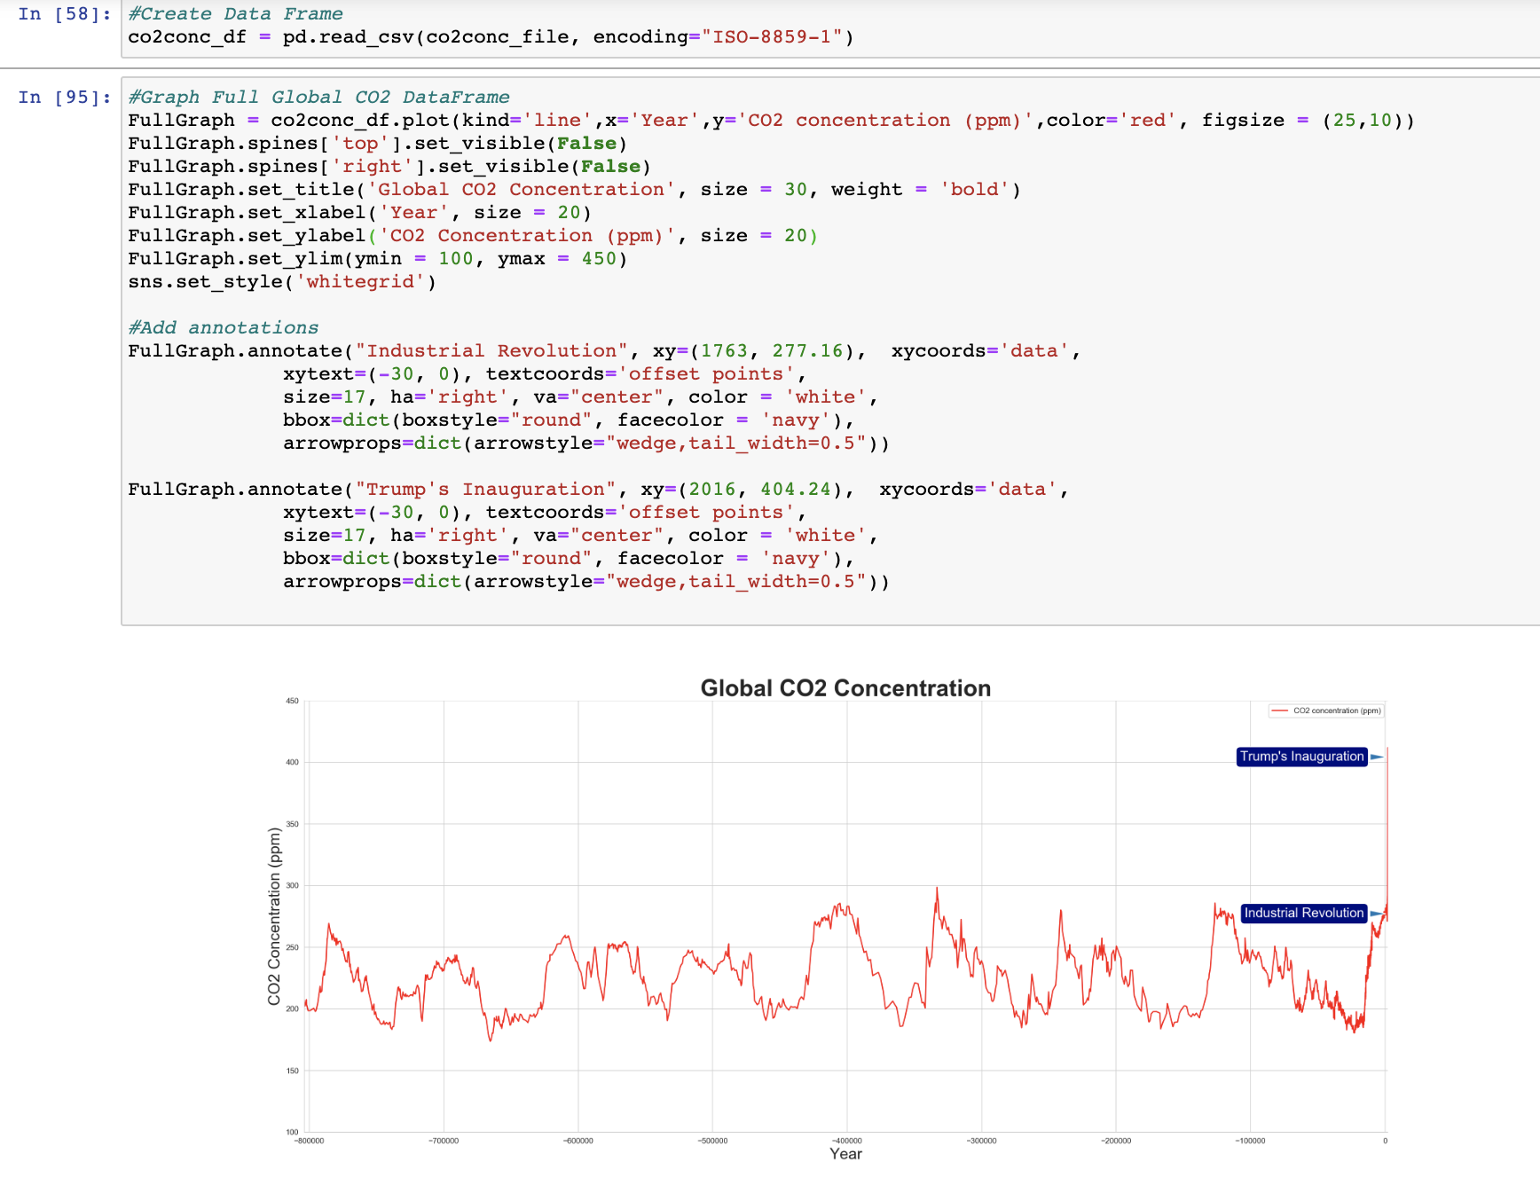
Read CSV data and insert it into a dataframe.
Plot line graph of all time CO2 concentration.
Add annotations for the start of the Industrial Revolution and Trump’s Inauguration to illustrate the drastic increase relative to historical trends.

Slide 28
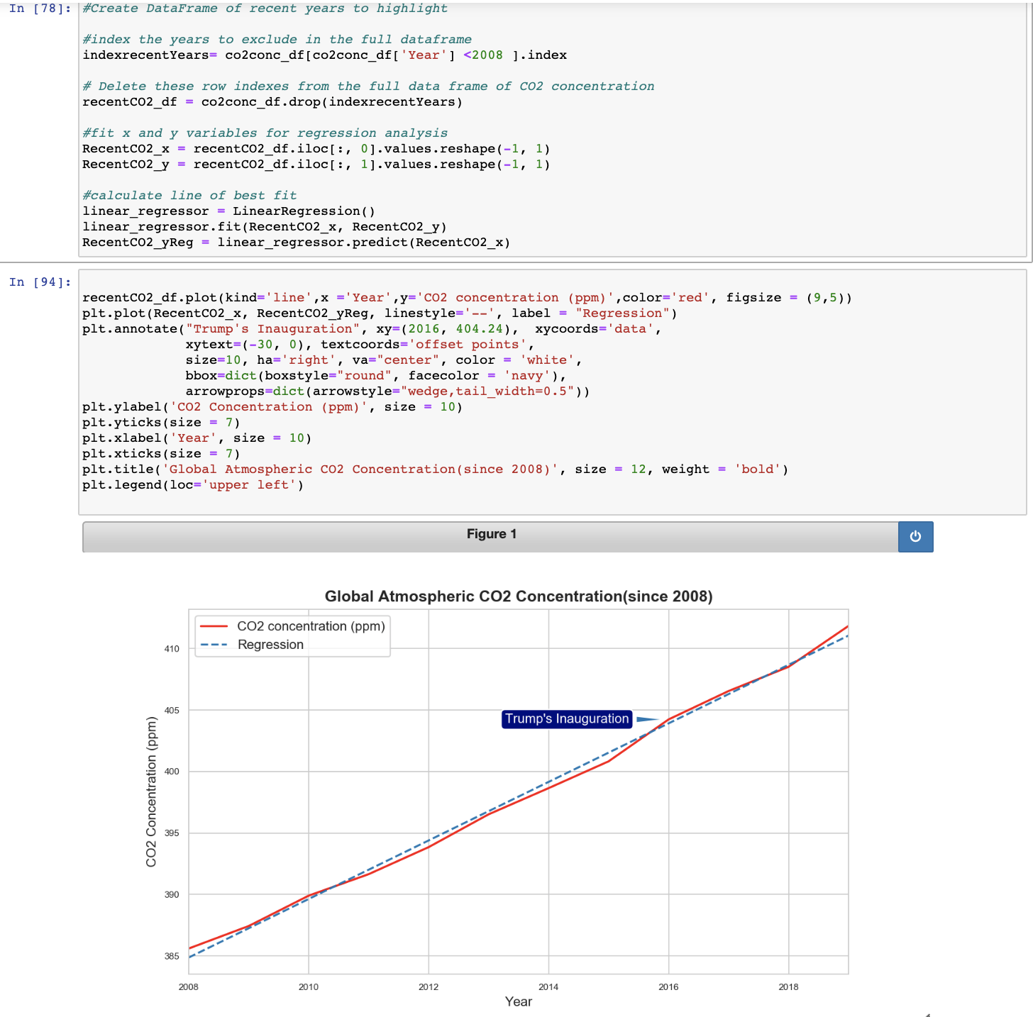
Isolate the years 2008- present by indexing the years before in the historical dataframe, and saving a new dataframe with those rows dropped.
Fit the x and y variables for regression analysis.
Calculate regression line
Plot the current years dataframe and overlay the regression line
Add annotation for Trump’s Inauguration to illustrate the transition in administrations

